Slide 1
How does CCP’s Crackdown of Anti-Extradition Bill Movement Impact Hong Kong’s Public Opinion?
Team Runaway
Agnes Xu, Anny Liu, Huanrui Chen, Tianle Ye
02.28.2024

Slide 2


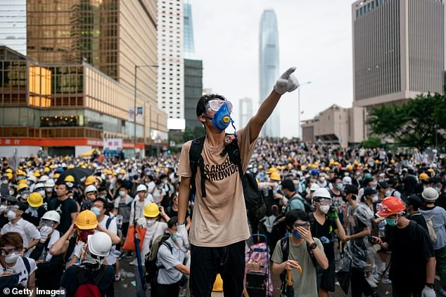
2019-2020 Hong Kong Anti-Extradition Bill Movement
The largest series of demonstrations in the history of Hong Kong
Seen by Hong Kong citizens as a significant challenge to the democracy and freedom of Hong Kong society

Slide 3
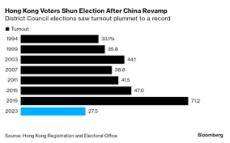
Aftermath
2020: Hong Kong National Security Law - deal with a series of acts that endanger national security. Many activists and protesters were put into jail.
2021: the CCP introduced an amendment to Hong Kong Basic Law - Only 88 out of the 470 seats in the Hong Kong Legislative Council can be directly voted by Hong Kong citizens, with the rest controlled by the CCP to varying degrees.
In the latest 2023 Hong Kong District Council Election, the turnout rate dropped to a historical low of 27%

Slide 4
Research Questions
How does public opinion on the Hong Kong government and conditions of the society differ before and after the Anti-Extradition Bill Movement?
How does such public opinion gathered in survey and on online social media forums differ?

Slide 5

Previous Literature: Public vs Private Preference
Kuran (1997): claims that citizens’ private preferences and public preferences toward a regime might differ dramatically. *
Hypothesis:
There is a gap between citizens’ publicly claimed political opinion gathered through survey and more privately communicated political preferences on social media platforms.
So our data sources are…
*Kuran, T. (1997). Private truths, public lies: The social consequences of preference falsification (sec. print). Harvard Univ. Press.

Slide 6


Data Source: Online forum and Survey
Online forum: lihkg.com
Survey: Hong Kong Public Opinion Research Institute

Slide 7
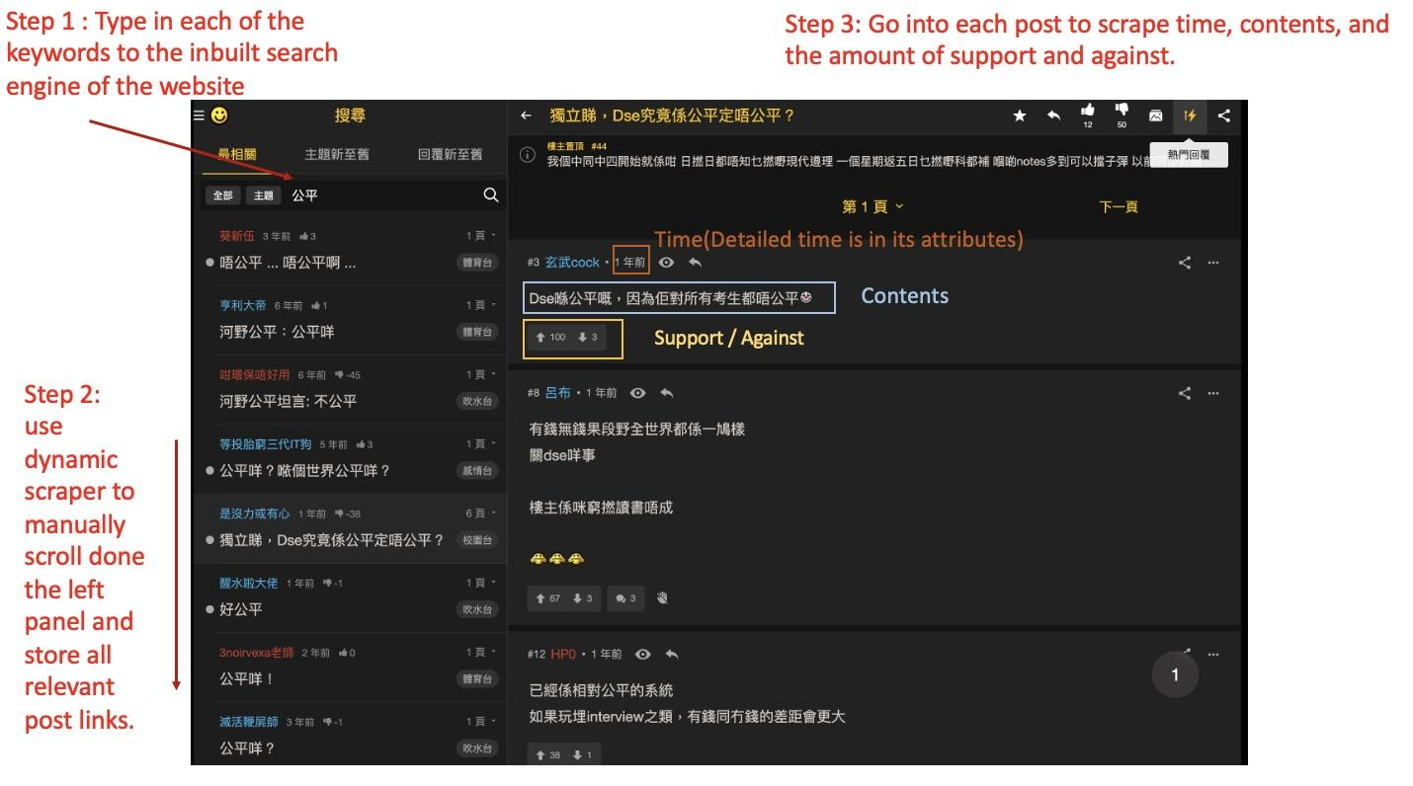

Slide 8
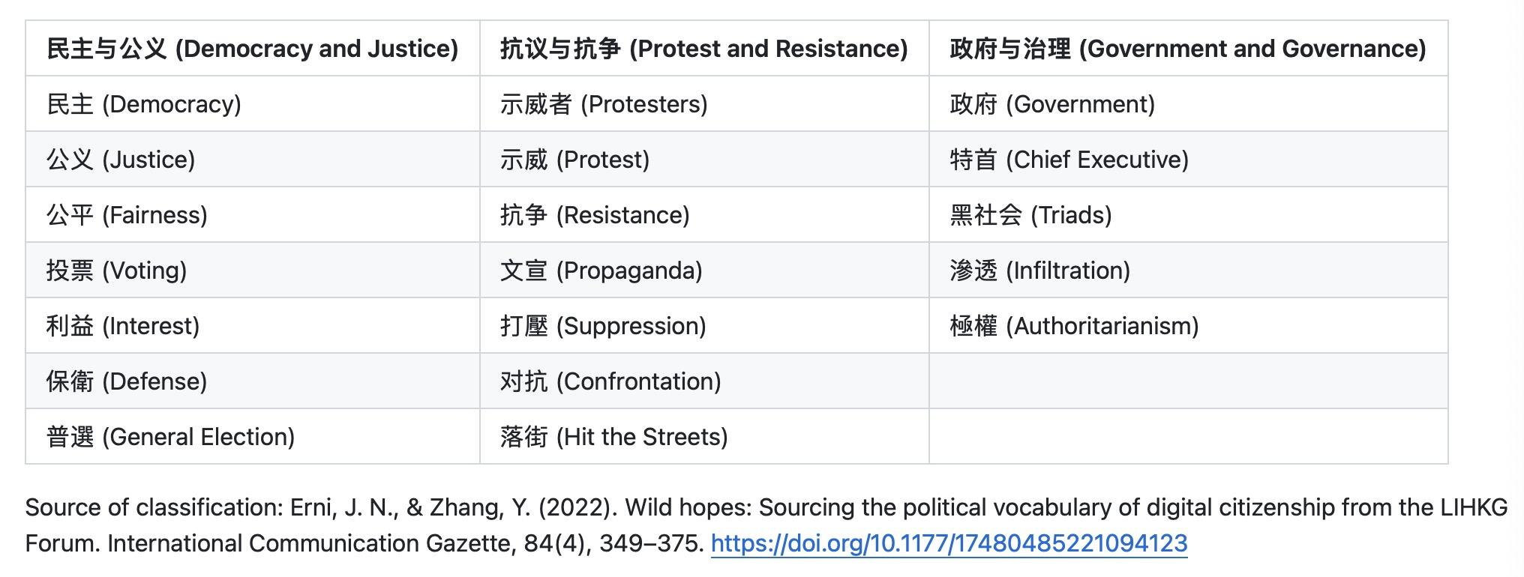
Keywords List

Slide 9

Problems of Web-Scraping and Solutions
The website is very sensitive to bot like activities
We use selenium to perform dynamic scraping to mimic human scrolling.
Selenium performs slowly; the public forum contains a lot of noisy, off-topic comments
Leverage the site's like-based ranking system to focus on the top 30 posts within each post. This strategy significantly reduced the noise from irrelevant content, enabling us to efficiently gather data across the three topics.
The site blocks IPs from time to time
Rotate the IP to bypass the block.
In total we scrapped 57,368 posts

Slide 10
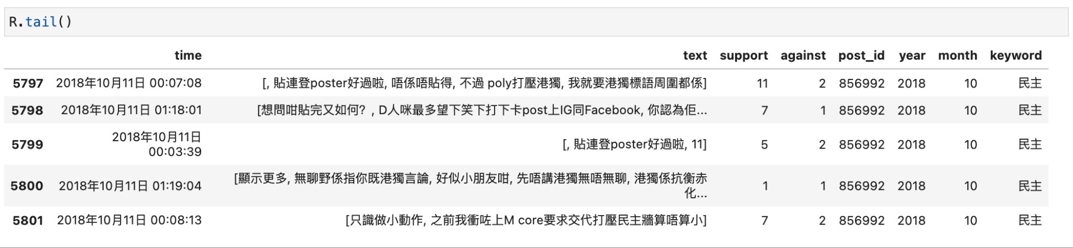
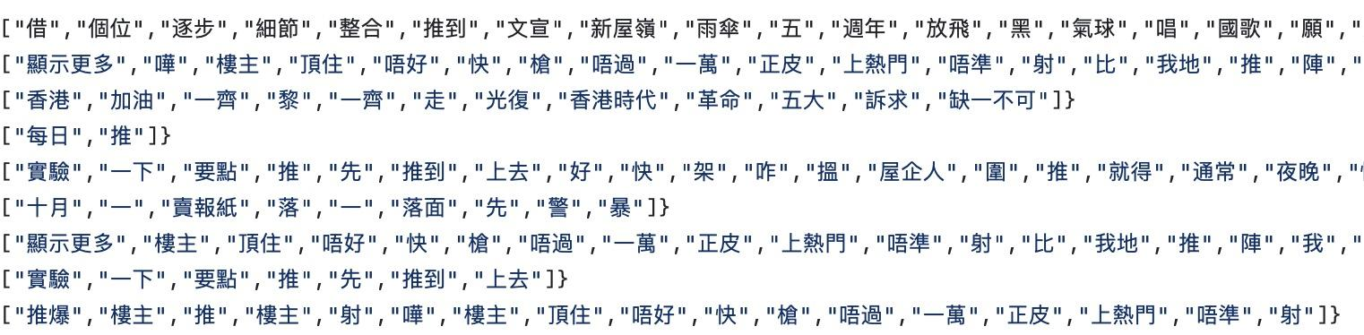

Data Wrangling
Format Conversion:
Use Pandas to structure the scraped data into CSV format, including post IDs, content, and time.
Text segmentation:
Chinese words problems: “中”（Mid）+“文”（Literature）= “中文”（Chinese）？
Using a tool named Pycantonese for text segmentation in Cantonese.
Splits text data into individual words or phrases for analysis.
We designed customized functions specifically to handle missing segmentation.

Slide 11

Data Wrangling
Translation:
Utilize Microsoft Translator API for automatic translation from Cantonese to English.
Data Joining:
Match and merge processed data with keyword lists using posts id data.

Slide 12
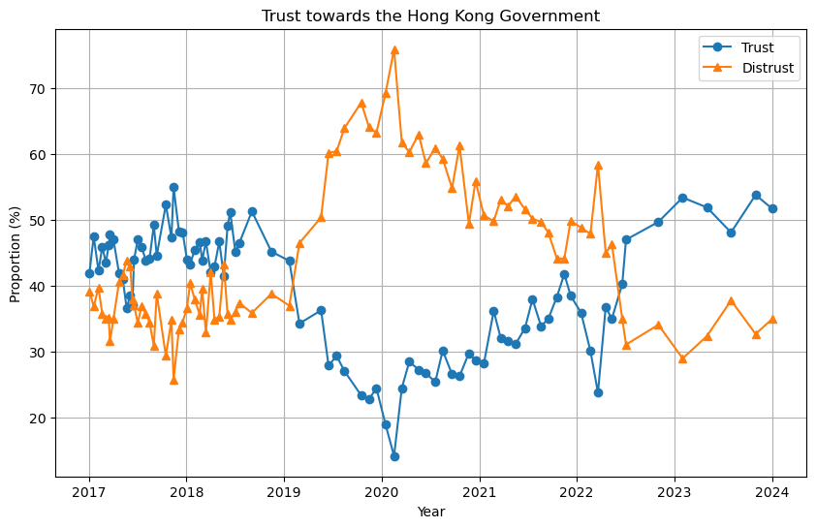
Results: Survey - Trust towards the Hong Kong Government

Slide 13
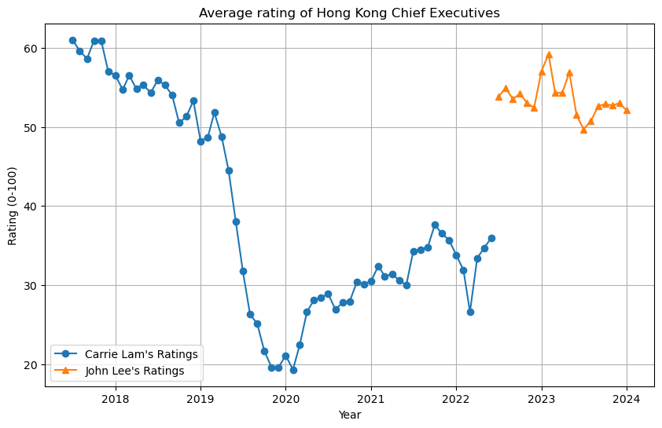
Average Rating of Hong Kong Chief Executives

Slide 14
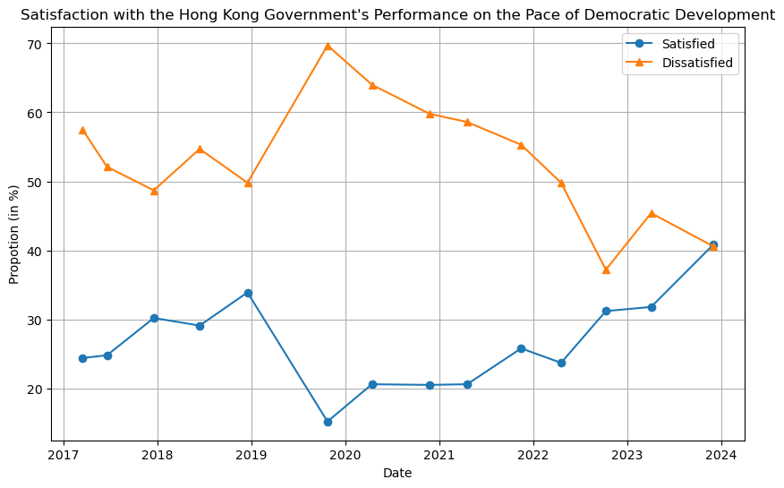
Satisfaction with the Democratic Development in Hong Kong

Slide 15
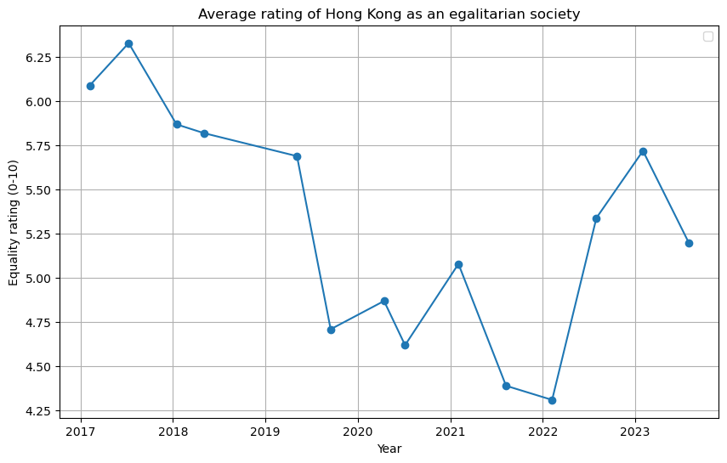
Average rating of Hong Kong as an Egalitarian Society

Slide 16
Survey Data: Findings and Implications
Question 1: How does public opinion towards Hong Kong society and the government differ before and after the Anti-Extradition Bill Movement?
Answer from the survey data:
Hong Kong citizens’ attitudes towards the Hong Kong government and society turned negative during the movement and turned positive after after CCP’s crackdown to a similar level as before the movement.
The movement seems to only impact the public opinion significantly during the movement.

Slide 17
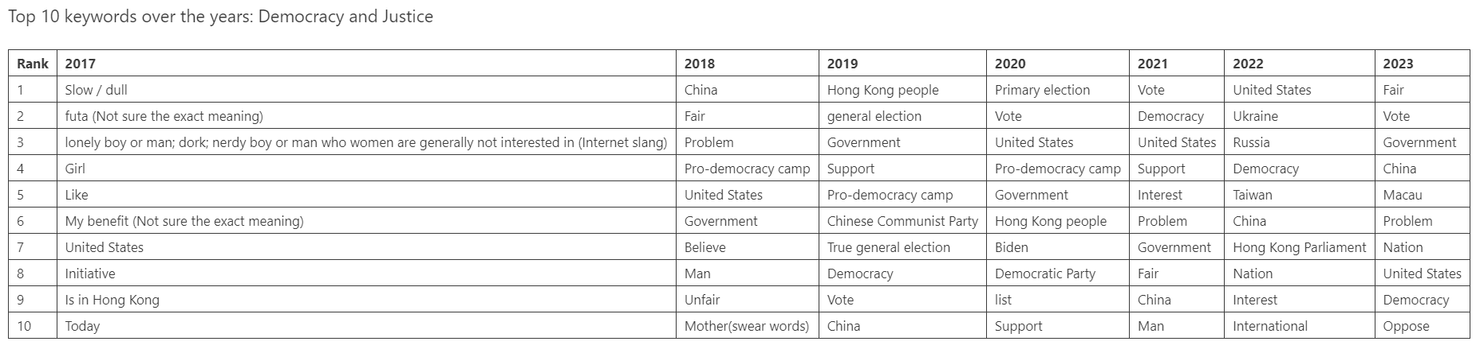
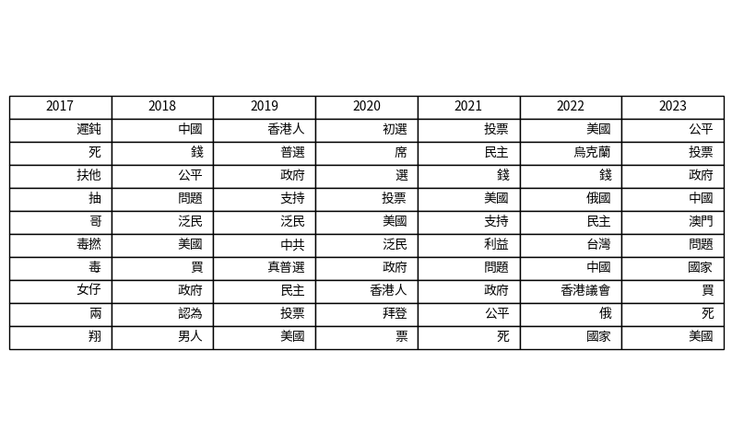
Results: Web Data – Word Frequency Count
Top 10 words with highest frequency for each topic
Topic: Democracy and Justice
Findings:
Some words related to democracy and justice such as “voting” and “democracy” remain top frequently appeared words after the movement
Some words related to specific organizations and concerns during the movement less frequently appeared after the movement such as general election, primary election, and pro-democracy camp

Slide 18
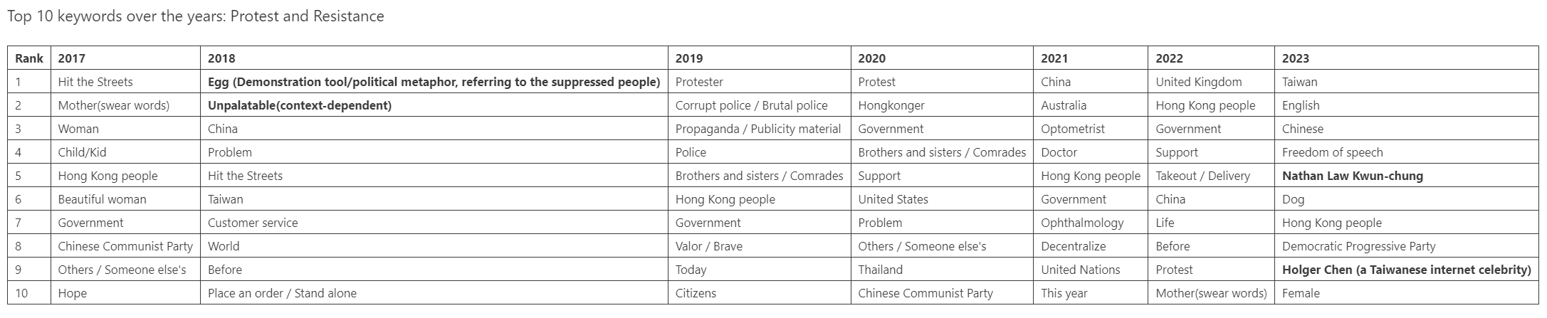
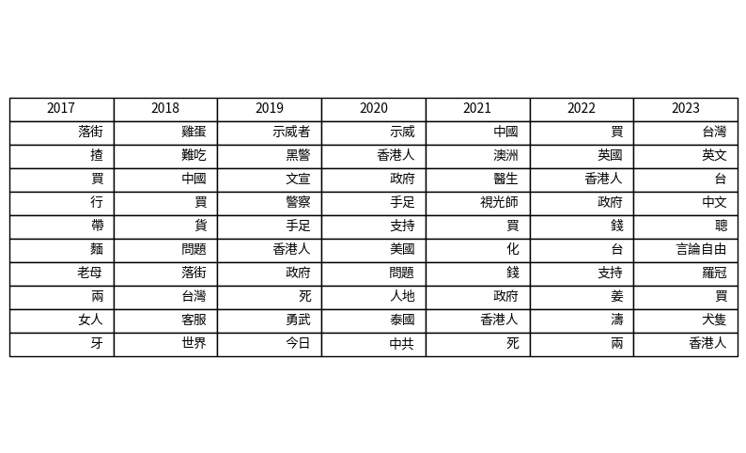
Word Frequency: Protest and Resistance
The words related to protest and resistance appeared much less frequently both before and after the movement than during the movement in this category. Most top frequently appeared words from 2017 to 2018 and from 2020 to 2023 are not relevant to protest and resistance.
Exceptions after the movement include freedom of speech and Nathan Law-Kwun-chung (a Hong Kong dissenter) in 2023.

Slide 19
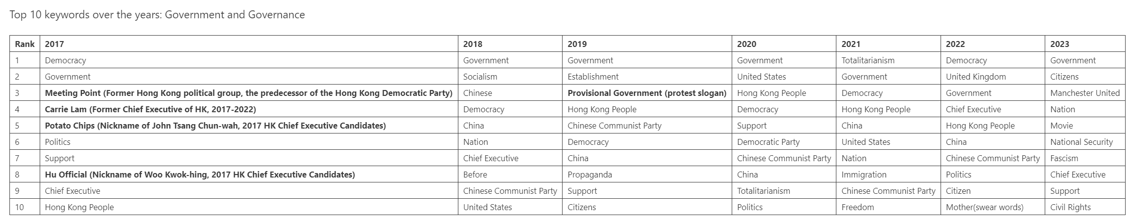
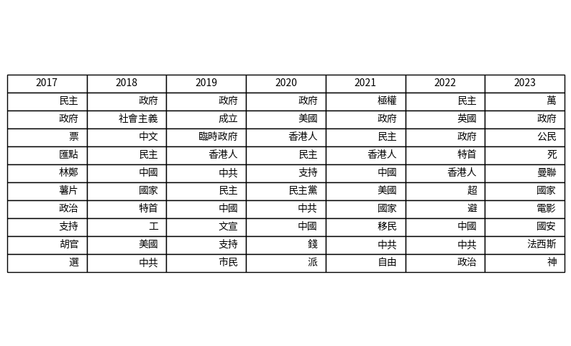
Word Frequency: Government and Governance
The discussion about government and governance continue after the movement
Two words worth specific attentions: totalitarian in 2021 and Fascism in 2023. Do they signal something special?

Slide 20
Word Frequency Count: Findings and Implications
The discussion of protest and resistance involved much less words relevant directly to its topic after the movement, signaling the wane of the discussion of protest and resistance after the CCP’s crackdown.
The discussions on democracy and justice and government and governance continued after the movement but with less attention to the specific political concerns and protest groups. Negative sentiments could still be detected in the discussion on these two topics after the movement.
Not exactly in line with the findings from the survey. Show different messages than the survey.

Slide 21
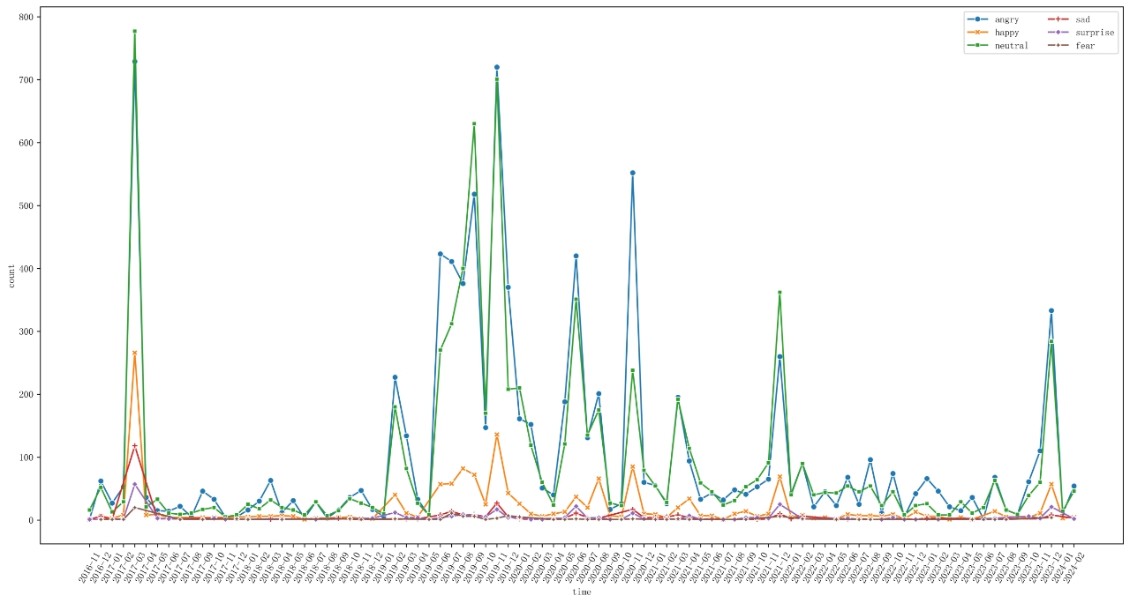
Sentiment Analysis: Democracy and Justice

Slide 22
Sentiment Analysis: Protest and Resistance

Slide 23
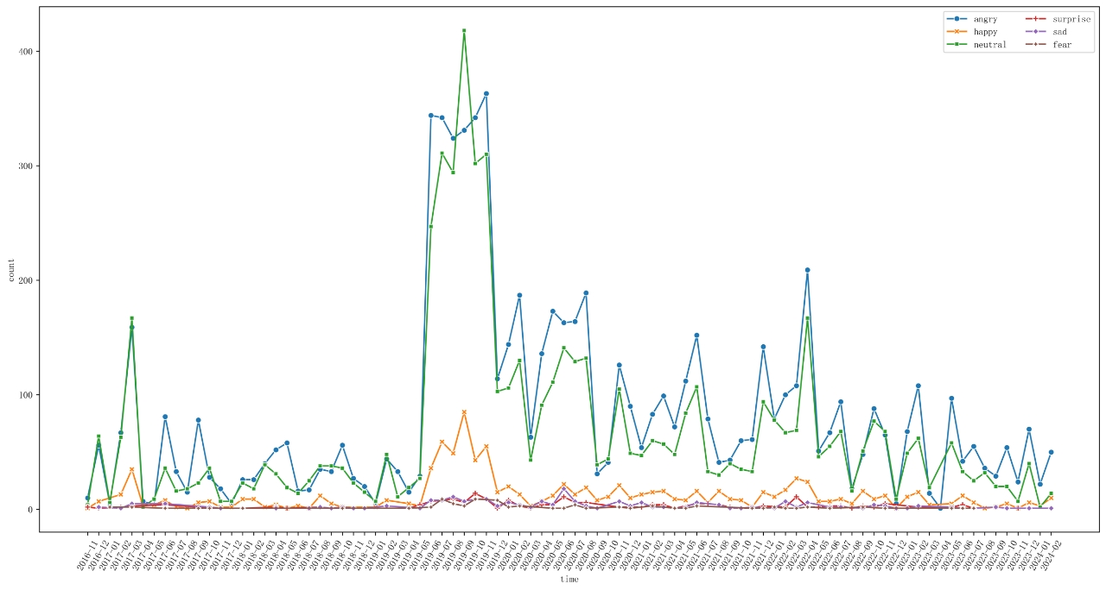
Sentiment Analysis: Government and Governance

Slide 24
Sentimental Analysis: Findings and Implications
For the discussions related to protest and resistance, there were a marked increase and a marked decrease of the same level in the angry sentiment before and after the movement. The angry sentiment before and after the movement are remarkably low.
The angry sentiment in the discussions on democracy and justice and government and governance first remarkably arose during the movement, then dropped to a mild level after the movement with a considerable level of fluctuations. In the democracy and justice graph, angry sentiments after the movement once reached more than three third of the highest level during the movement in October 2020.
In general:
The sentimental analysis shows that the angry sentiment after the movement at large dissolved in the discussion of protest and resistance while retained at a mild level in the discussions of democracy and justice and government and governance with some fluctuations. This suggests that in contrast with the survey data, the angry/negative sentiments were retained in the public discussions of the Hong Kong government and the condition of Hong Kong society.

Slide 25
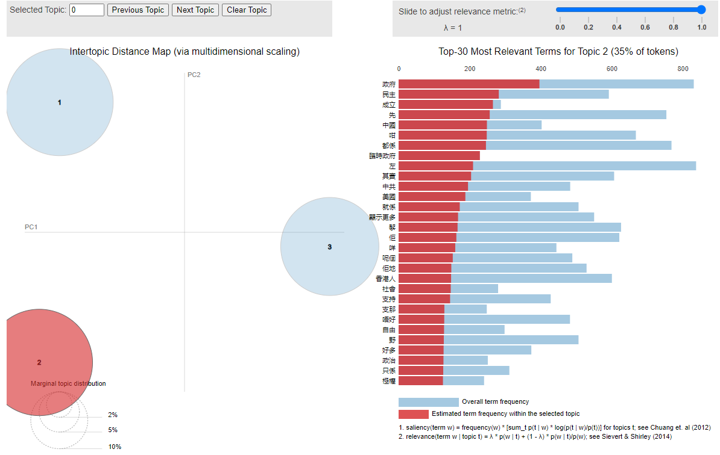
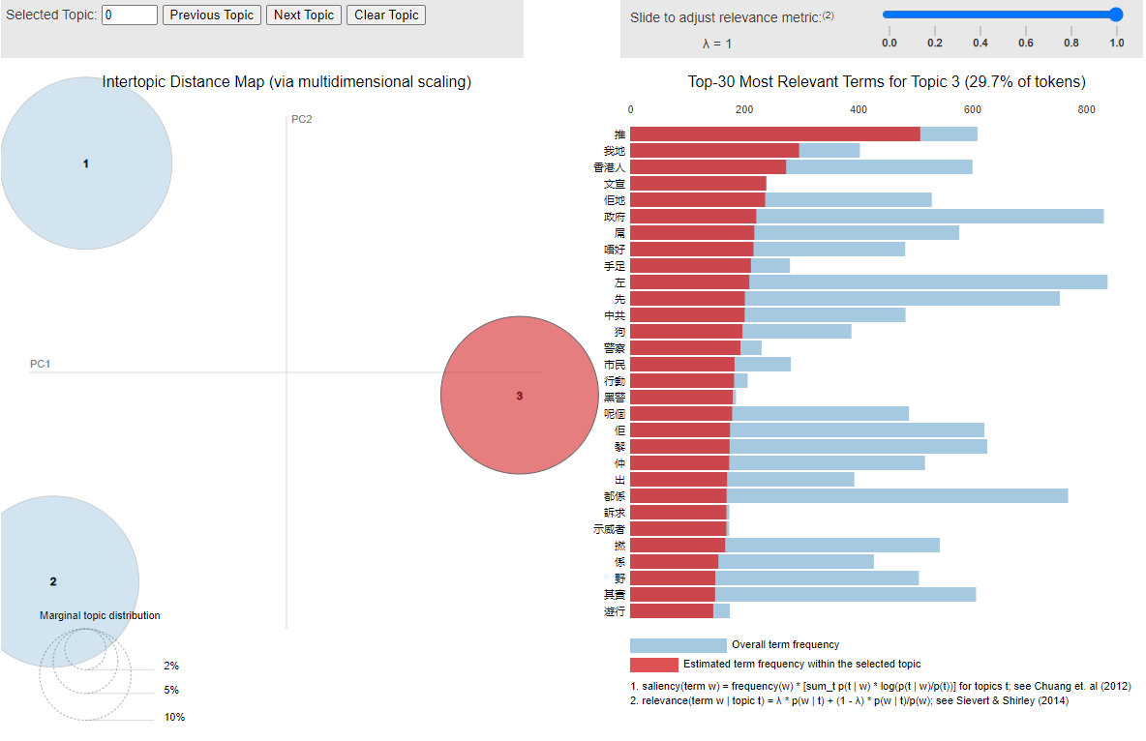
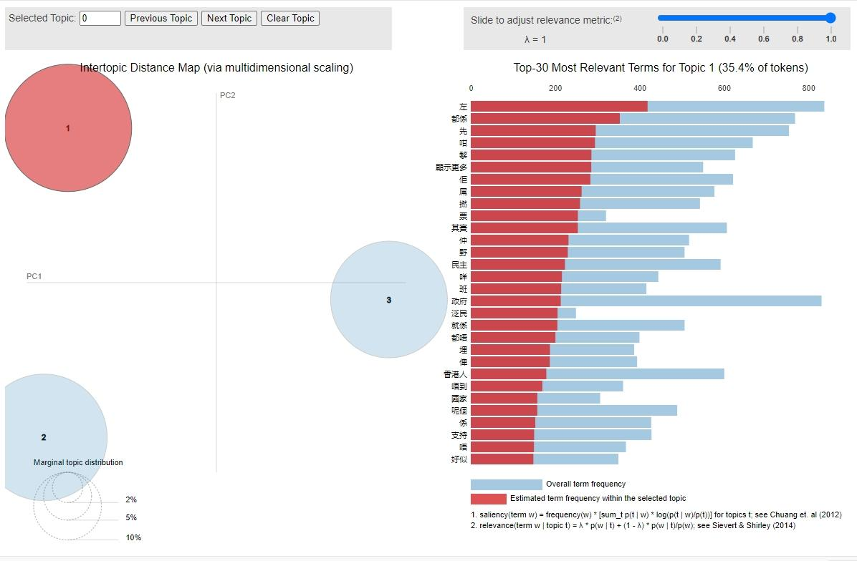
Dynamic Topic Modelling
Topics: non conclusive and overlapping
If we have to name three topics:
Topic 1: related to government/provisional government
Topic 2: democracy and freedom
Topic 3: related to pro-democracy campaign

Slide 26
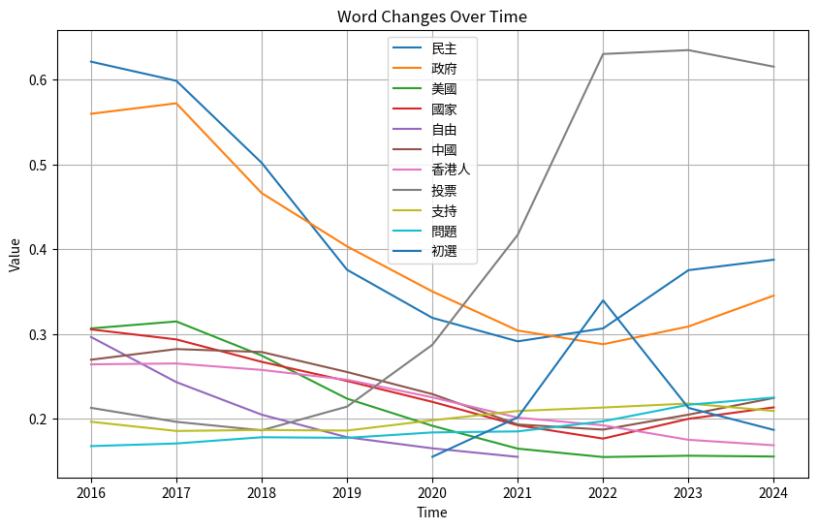
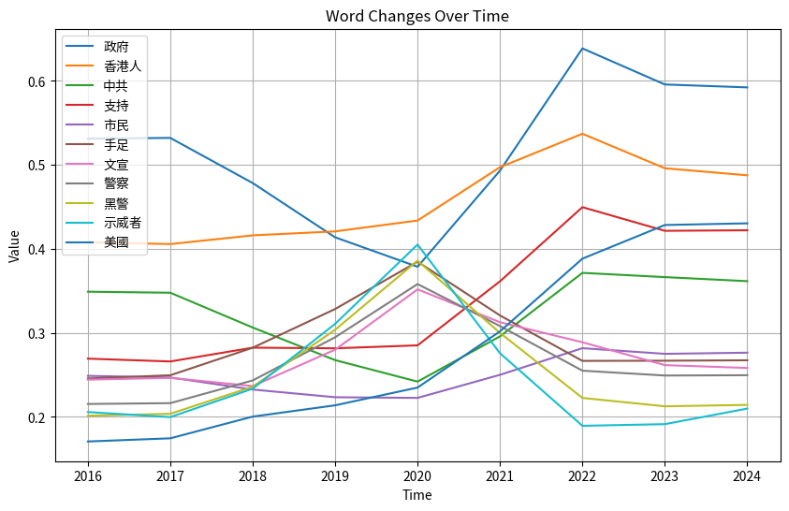
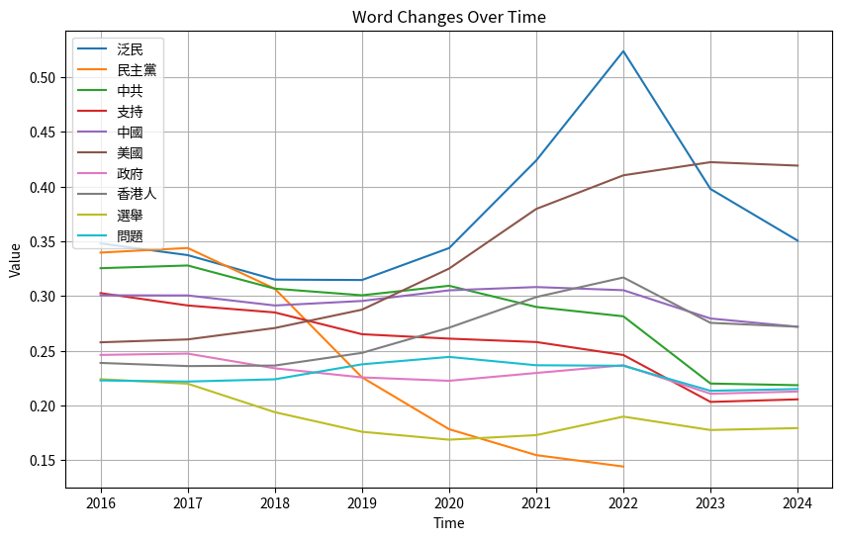
Dynamic Topic Modelling
Hard to interpret

Slide 27
Conclusion and Take-Home Points
From the survey data, we find that Hong Kong citizens’ attitudes towards the Hong Kong government and chief executives and assessment of the Hong Kong society turned negative during the Anti-Extradition movement and turned positive after after CCP’s crackdown to a similar level as before the movement.
In contrast, from the web data, we find that Hong Kong citizens’ attitudes towards the Hong Kong government and society worsened considerably during the movement and the negative sentiments such as angry could still be identified in the discussion of Hong Kong government and the condition of the society after the movement. This trend is reflected both in the change of word frequency count and sentimental analysis
In general
The public opinion gathered from survey data and online social media platforms show a meaningful gap. While the survey shows that negative sentiments seem to retreat after the movement was halted, the online web data suggest that such sentiment retained in the discussion of the Hong Kong government and society.
As such we confirm the hypothesis that there is a gap between public opinion gather through survey and online platforms.

Slide 28
Reflections…

